Slide 1

SMART INDIA HACKATHON 2026
SINISTER SIX*
Problem Statement ID: SIH26033
Problem Statement Title: Multiple intermediaries reduce farmer earnings and increase consumer prices.
Theme: Agriculture, FoodTech & Rural Development
PS Category: Software
Team ID- 139407
Team Name: SINISTER SIX*

Slide 2

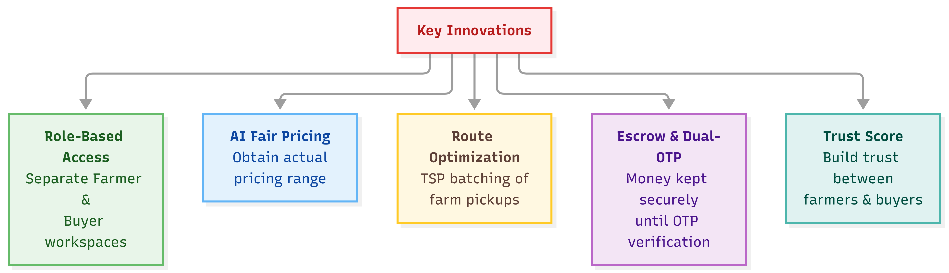
KisanSetu- Direct Marketplace for Famers & Buyers
SINISTER SIX*
Understanding The Problem​
Our Solution
Intermediate Fragmentation: Produce goes through 4-6 layers of intermediaries (aggregators, arhatiyas, and wholesalers), which drain out value without giving back any commensurate utility.
Low Farmer Realization: Farmers realize only 30-35% of the final consumer price for perishables (proved by studies by NABARD/ICAR).
Price Inflation for Consumers: Consumers have to pay 2-3x the farm-gate price due to the cumulative margins and inefficiencies in logistics systems.
Price Discovery Through Obscure Channels: The perishable nature of produce creates vulnerabilities for farmers in distress sales and market manipulation.
Trust and Transport Bottleneck: Lack of reliable buyer channels and transport logistics prevents stranger-to-stranger transactions.
Direct Digital Marketplace: Links up farmers with buyers without intermediaries through transparency in e-commerce discovery.
AI-powered Fair Pricing: Intelligent real-time market information system avoids distressed selling and ensures fair price.
Verified Buyer Network: Creates trust and verification channels for safe transactions of valuable, perishable goods.
Integrated Last-Mile Logistics: Helps overcome major agri-tech challenges through route optimization & order tracking.
Modern Hybrid Mandi Coexistence: Disintermediation of trade without excluding traditional mandis if so desired.
Vernacular & Rural-First Accessibility: Hindi + English support and a mobile-responsive UI built for low-bandwidth rural networks
Live Prototype (60% Working)
(Kisansetu-Agri-Marketplace)

Slide 3
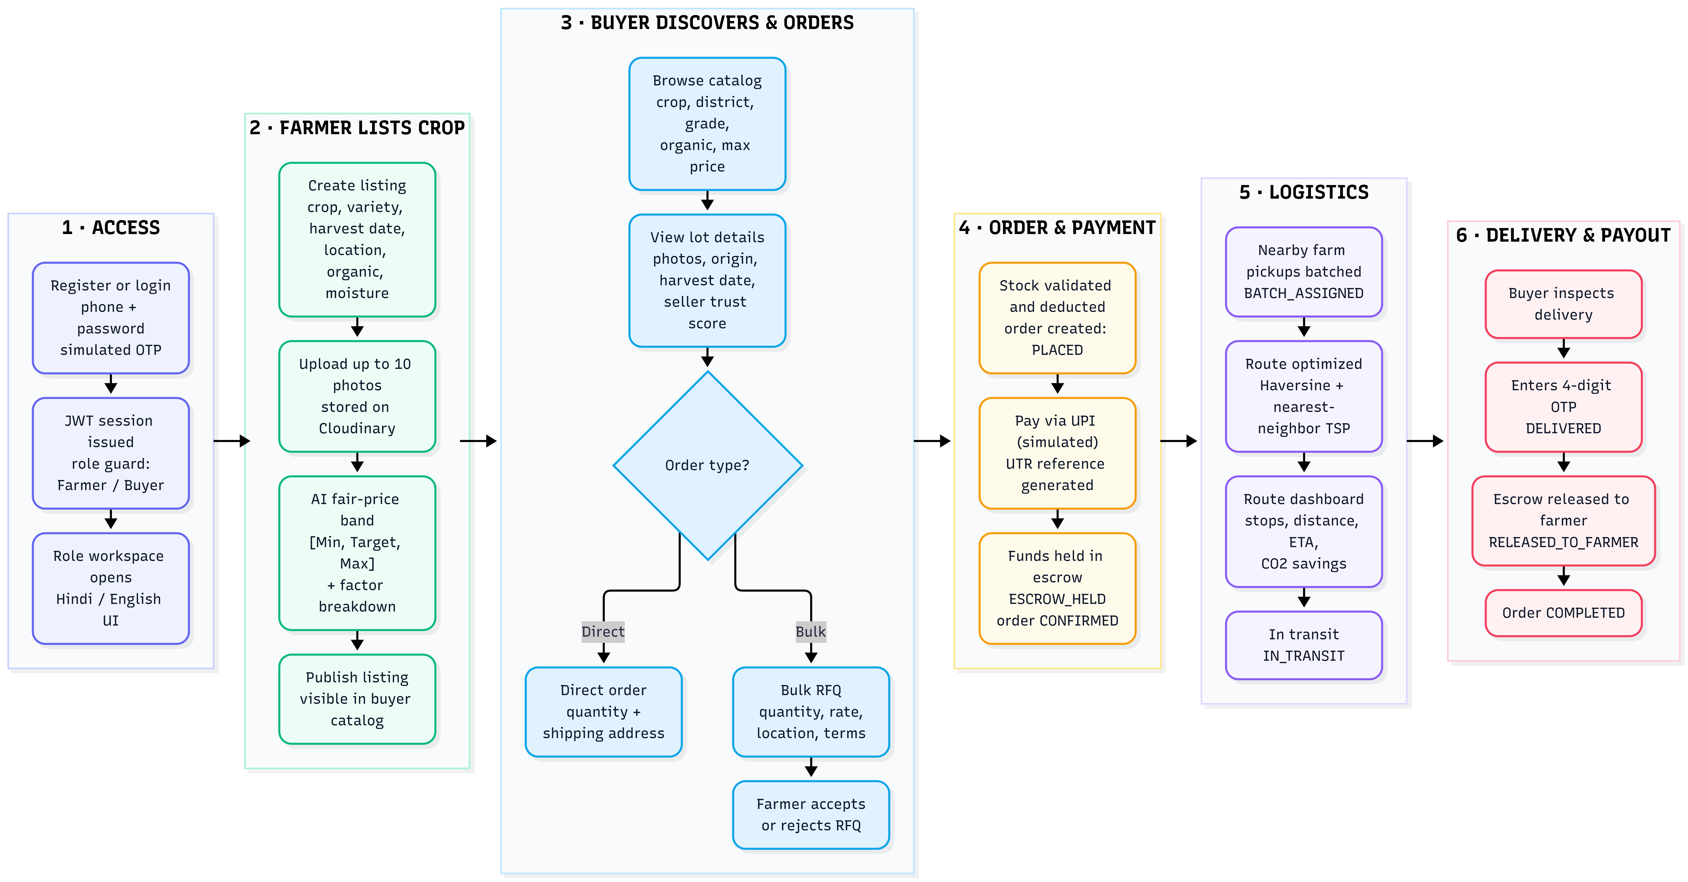

TECHNICAL APPROACH
SINISTER SIX*
Technology Stack
Kisansetu-Workflow
Frontend : React 19, Vite 6, Tailwind CSS 4 mobile-first interface for Farmers and Buyers, in Hindi and English.
Backend: Python + FastAPI (Uvicorn, Pydantic v2) REST APIs for auth, listings, photo uploads, pricing, orders, payments, RFQs, logistics and analytics.
Database: PostgreSQL / SQLAlchemy 2.0 + SQLite (default) Store users, crops, orders.
AI / Machine Learning: Python + Scikit-learn ( NumPy, Pandas). Fair price band [Minimum, Target, Maximum] based on training on APMC mandi trading history.
Logistics: Haversine formula + TSP Multi-farm batch pickup routing and an analysis.
Authentication & Security: JWT + bcrypt, role-based access Phone/password login with simulated OTP
Deployment & Services: Vercel (frontend + edge CDN) + Render (FastAPI backend) + Neon (PostgreSQL)
Supporting Services: Cloudinary (image storage and CDN), UptimeRobot (keep-alive pings ), GitHub Actions (weekly encrypted database backups)
Scan Me
Github Repo
(Source Code)

Slide 4
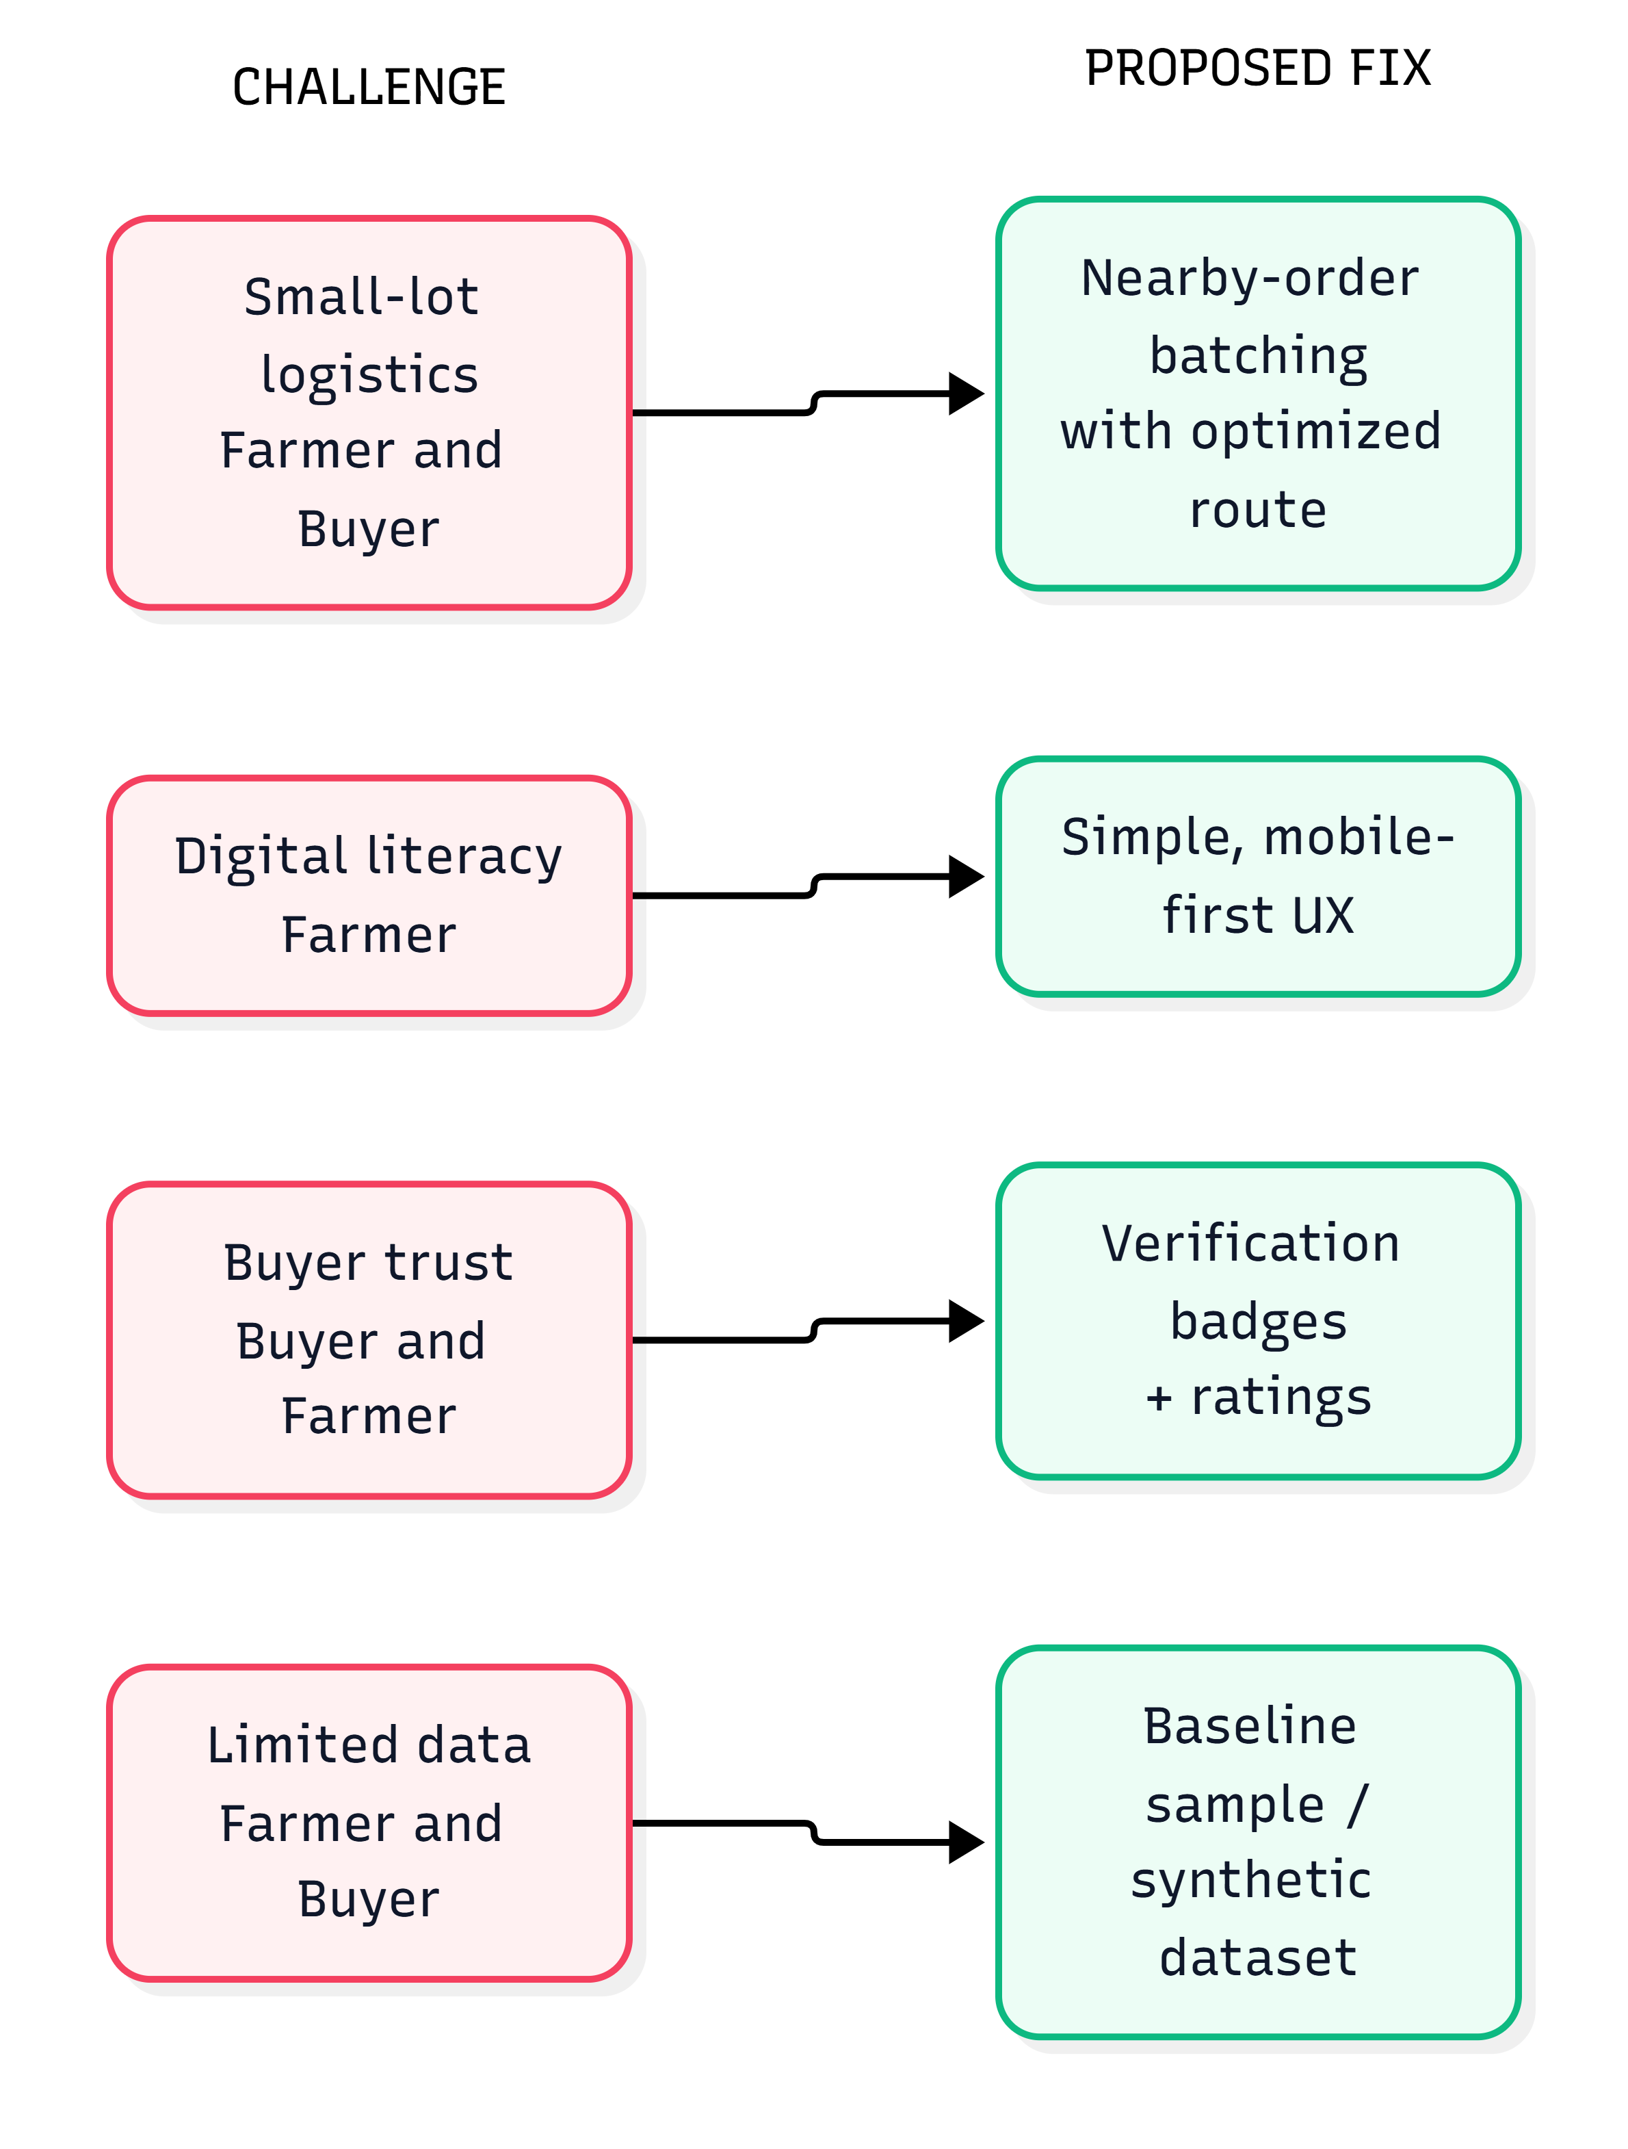
FEASIBILITY AND VIABILITY
SINISTER SIX*
Feasibility of the Idea
Challenge → Fix (Mitigation)
Built on mature, widely used technologies (React 19, FastAPI, PostgreSQL,scikit-learn)
Core modules implemented: Farmer/Buyer workspaces (RBAC), AI fair-price engine, TSP route optimization, Hindi/English UI
Developed security framework: JWT/bcrypt authentication, rate limiting, validation
Deployed on Vercel + Render + Neon PostgreSQL, using Cloudinary for image storage
Mobile-first, bilingual UI designed for low-bandwidth rural networks
1. Digital Literacy → Simple, Mobile-First UX
Challenge (Farmer): Farmers with limited digital literacy may find a marketplace app hard to use.
Proposed fix: Keep the experience simple and mobile-first, so a farmer can list produce and see a fair price without complex steps.
2. Buyer Trust → Verification + Ratings
Challenge (Buyer and Farmer): Buyers can't inspect produce or judge seller reliability remotely
Proposed fix: Verification badges on farmer and buyer profiles, plus ratings after completed orders
3. Small-Lot Logistics → Nearby-Order Batching
Challenge (Farmer and Buyer): Small lots are costly to move one by one, and perishables lose value in uncoordinated transit
Proposed fix: Group nearby orders and farm pickups into one shared transit batch, with stops sequenced by an optimized route.
4. Limited Data → Baseline Sample / Synthetic Dataset
Challenge (Farmer and Buyer): A new platform has little transaction history, which can weaken the fair-price band and benchmarks.
Proposed fix: Bootstrap the pricing engine with a baseline sample/synthetic dataset
Challenges and Fixes
Practical value (platform analytics)
Farmer price realization: 61.8% vs. 32.4% mandi baseline
19.5% consumer savings, 4 of 5 intermediary layers bypassed
Up to 33.5% less transport distance through batched pickups
Calculations based on (NABARD/ICAR Studies)

Slide 5
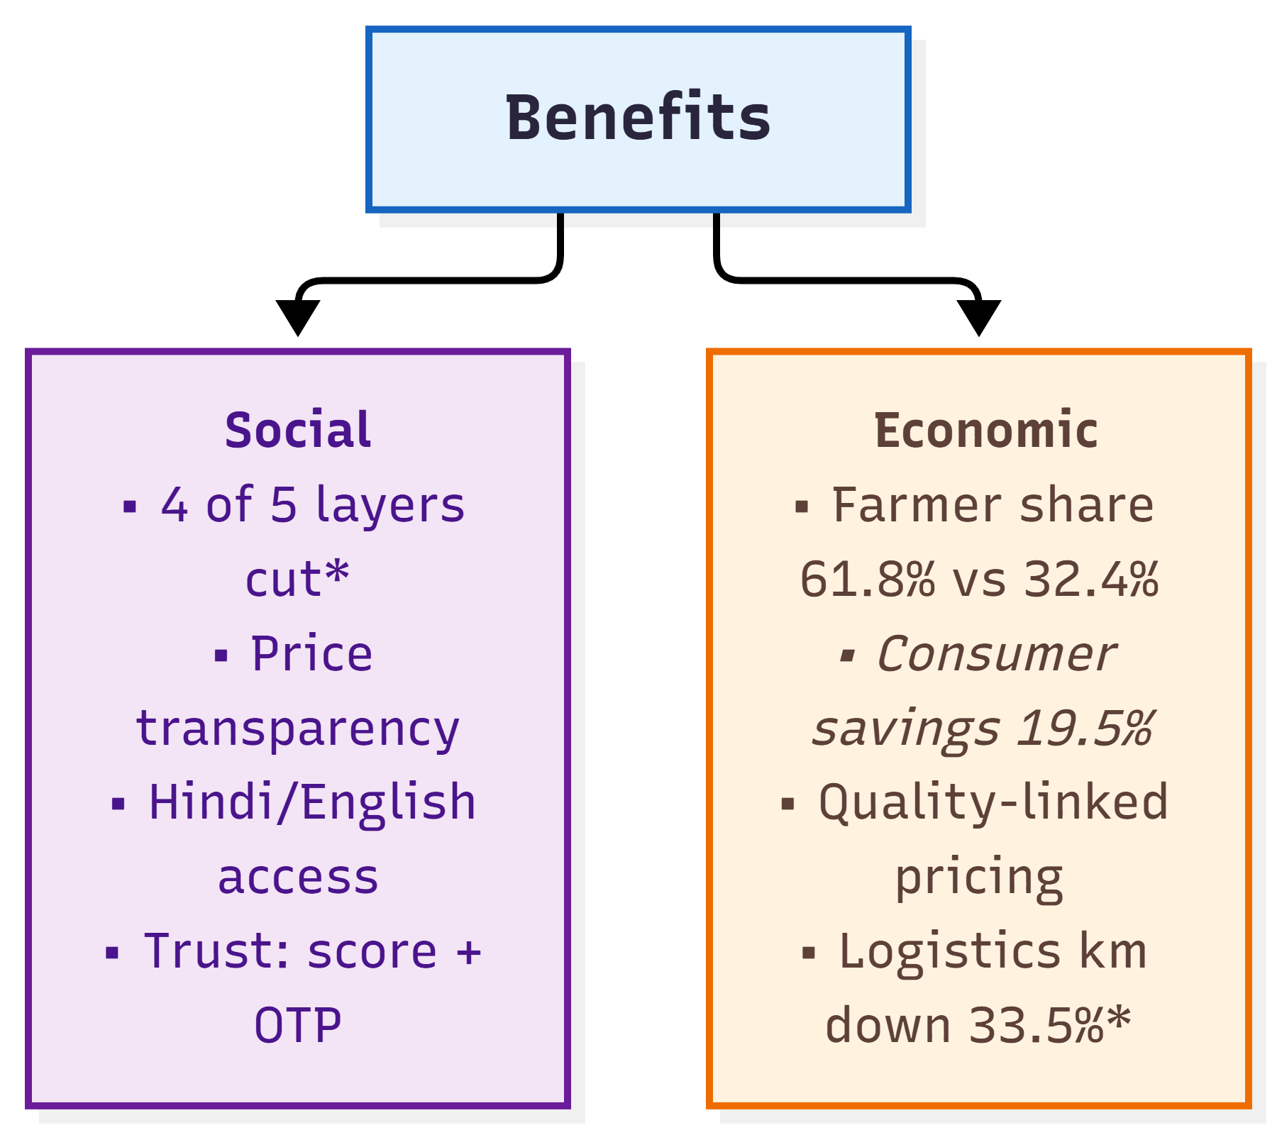
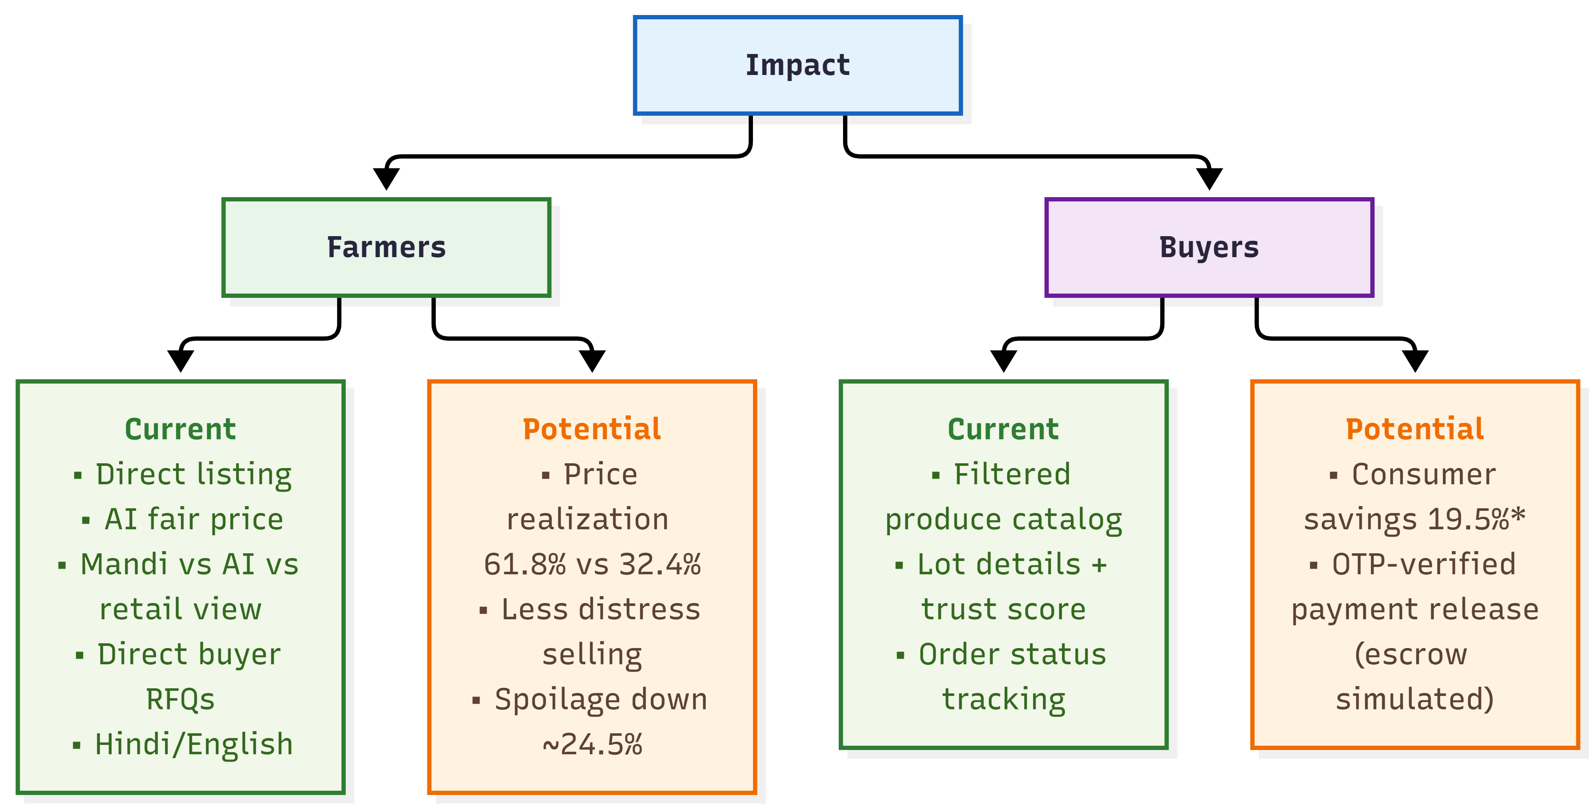
IMPACT AND BENEFITS
SINISTER SIX*
Impacts on Framers
Impacts on Buyers (Consumers)
List Crops directly with grade, harvest date, organic certification, packaging
Get an AI fair price band [Min, Target, Max] per quintal while creating a listing
See mandi rate vs AI fair price vs retail price side by side
Receive RFQs and purchase requests directly from wholesale buyers
Browse a catalog filtered by crop, grade, district, organic certification and max price
View lot details: farm origin coordinates, harvest date, seller trust score, packaging
Submit bulk RFQs and place farm-gate purchase orders
Track orders through PLACED → CONFIRMED → BATCH_ASSIGNED → IN_TRANSIT → DELIVERED → COMPLETED
Potential
  Price realization of 61.8% vs 32.4% in the traditional mandi baseline
  Less distress selling, through AI fair pricing
  Lower transit wastage through batched pickups (~24.5% estimated spoilage reduction)
Potential​
  19.5% consumer price savings
  Payment released only after a buyer-provided delivery OTP on physical inspection (escrow is currently a simulation)

Slide 6
RESEARCH AND REFERENCES
SINISTER SIX*
Research
Examined e-NAM for online agricultural trading, price transparency, and connectivity between farmers and buyers.
Explored the model of Farmer Producer Organisation (FPO) for aggregation of small farmers and market accessibility.
Used AI agents for research (Claude, Gemmni, Chatgpt)
Examined current agricultural marketplaces in order to find out the flaws in small lot aggregation, trust of buyers, logistics optimization, and price recommendation using AI.
Reviewed government initiatives supporting digital agriculture and direct market linkages.
References
e-NAM (National Agriculture Market), Government of India: https://enam.gov.in
Small Farmers' Agri-Business Consortium (SFAC), Ministry of Agriculture & Farmers' Welfare: https://www.sfacindia.com
Farmer Producer Organization(FPO) Scheme, SFAC: https://www.sfacindia.com/FPOS.aspx
NABARD, Farmer Producer Organizations & Agricultural Market Linkages: https://www.nabard.org/contentsearch.aspx?AID=95&Key=ntro
Ministry of Agriculture & Farmers' Welfare, Government of India

